Slide 1
Creational Patterns –Part II
Emre Kaplan, Ph.D.

Slide 2
Creational Patterns
Creational design patterns abstract the instantiation process.
They help make a system independent of how its objects are created, composed, and represented.
A class creational pattern uses inheritance to vary the class that's instantiated, whereas an object creational pattern will delegate instantiation to another object.
Creational patterns
Singleton
Builder
Factory Method
Abstract Factory
Prototype
Object Pool

Slide 3
Creational Patterns
Hide how instances of classes are created and put together
Flexibility in what gets created, who creates it, how it gets created, and when.

Slide 4
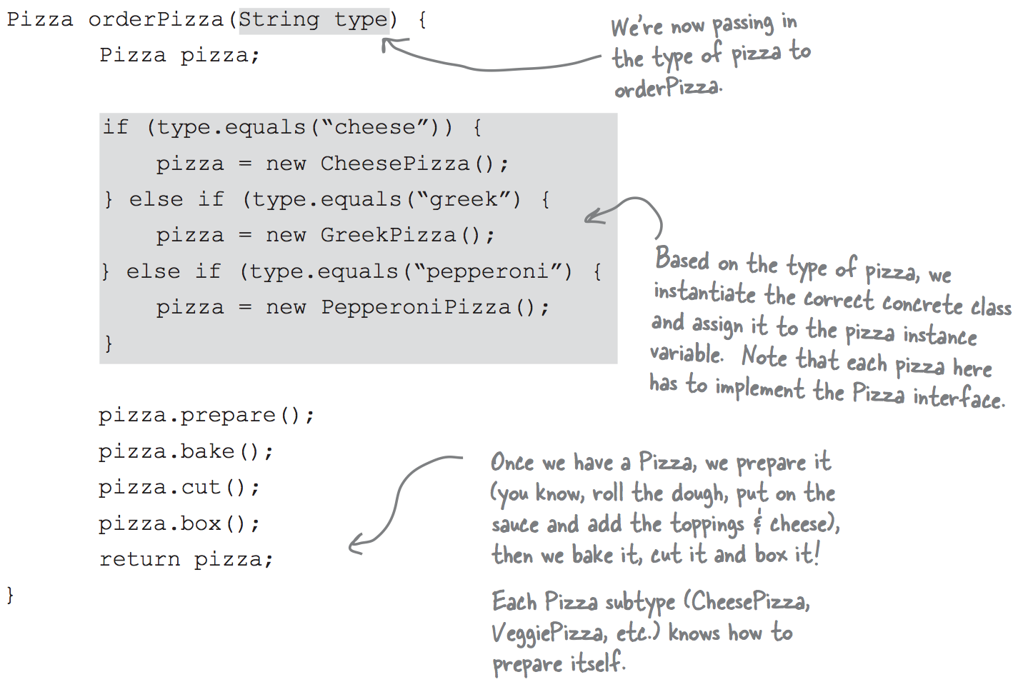
Simple Factory
Source: Freeman, E., Robson, E., Sierra, K., & Bates, B. (2004). Head First design patterns. Sebastopol, CA: O'Reilly.

Slide 5
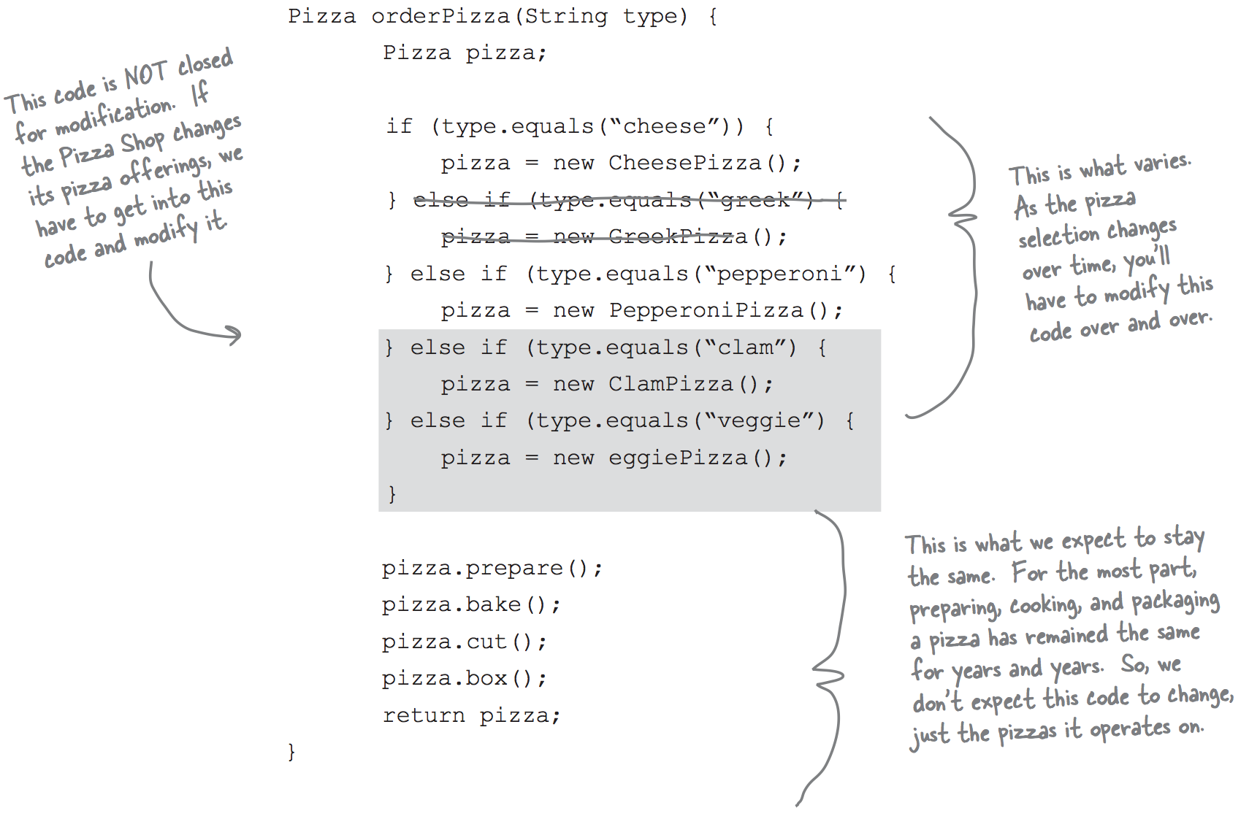
Simple Factory

Slide 6
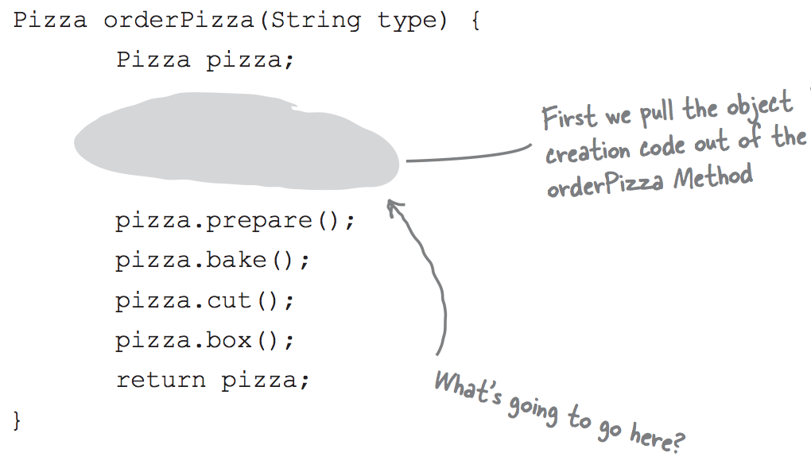
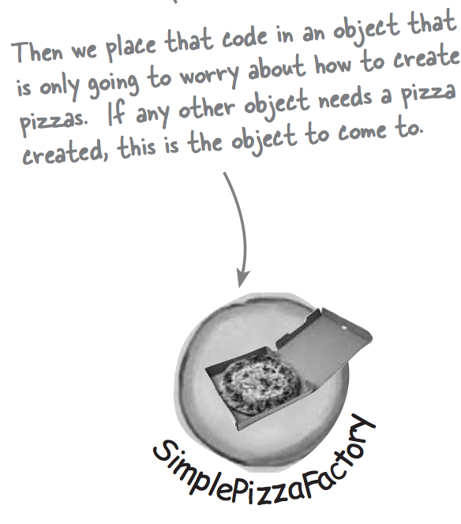
Simple Factory

Slide 7
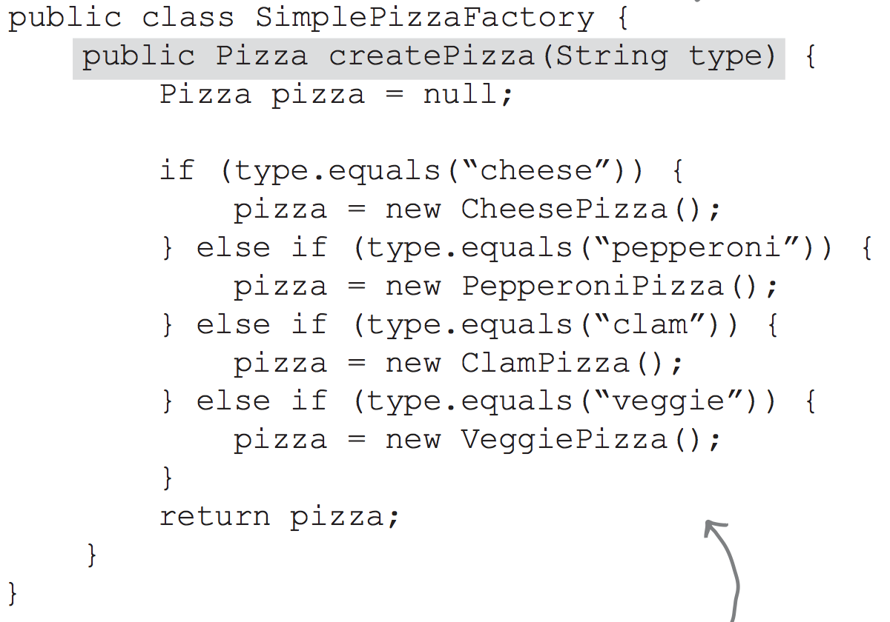
Simple Factory

Slide 8
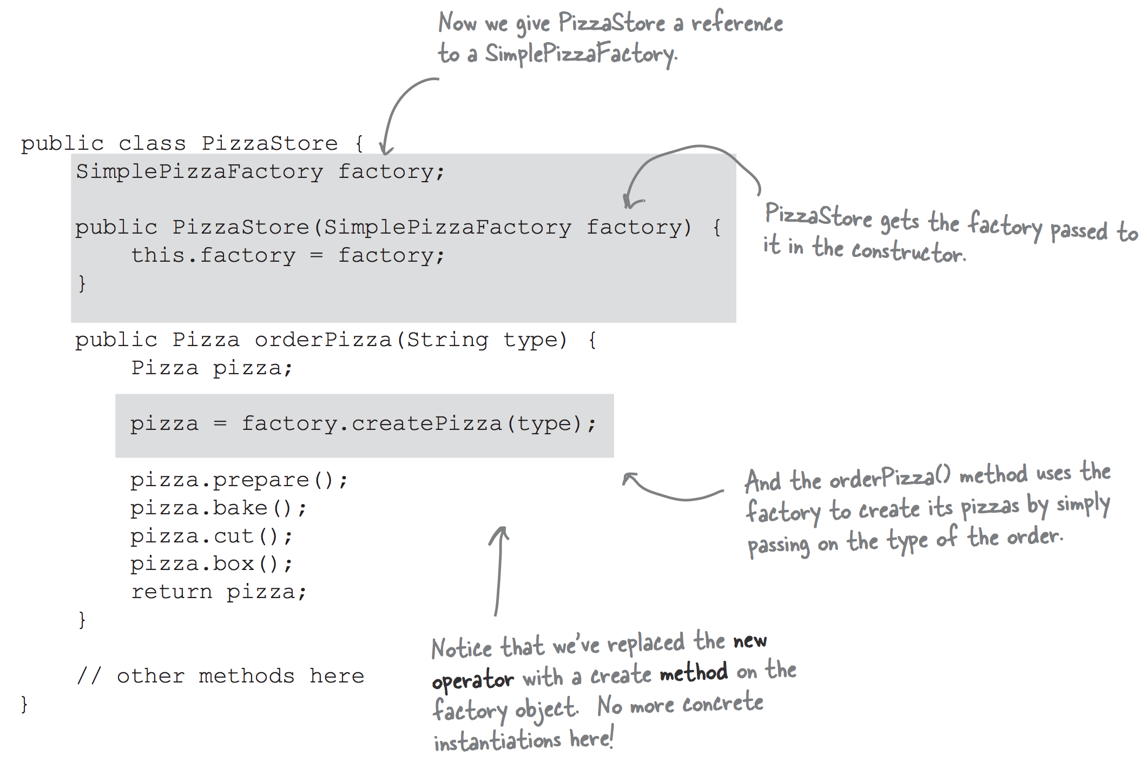
Simple Factory

Slide 9
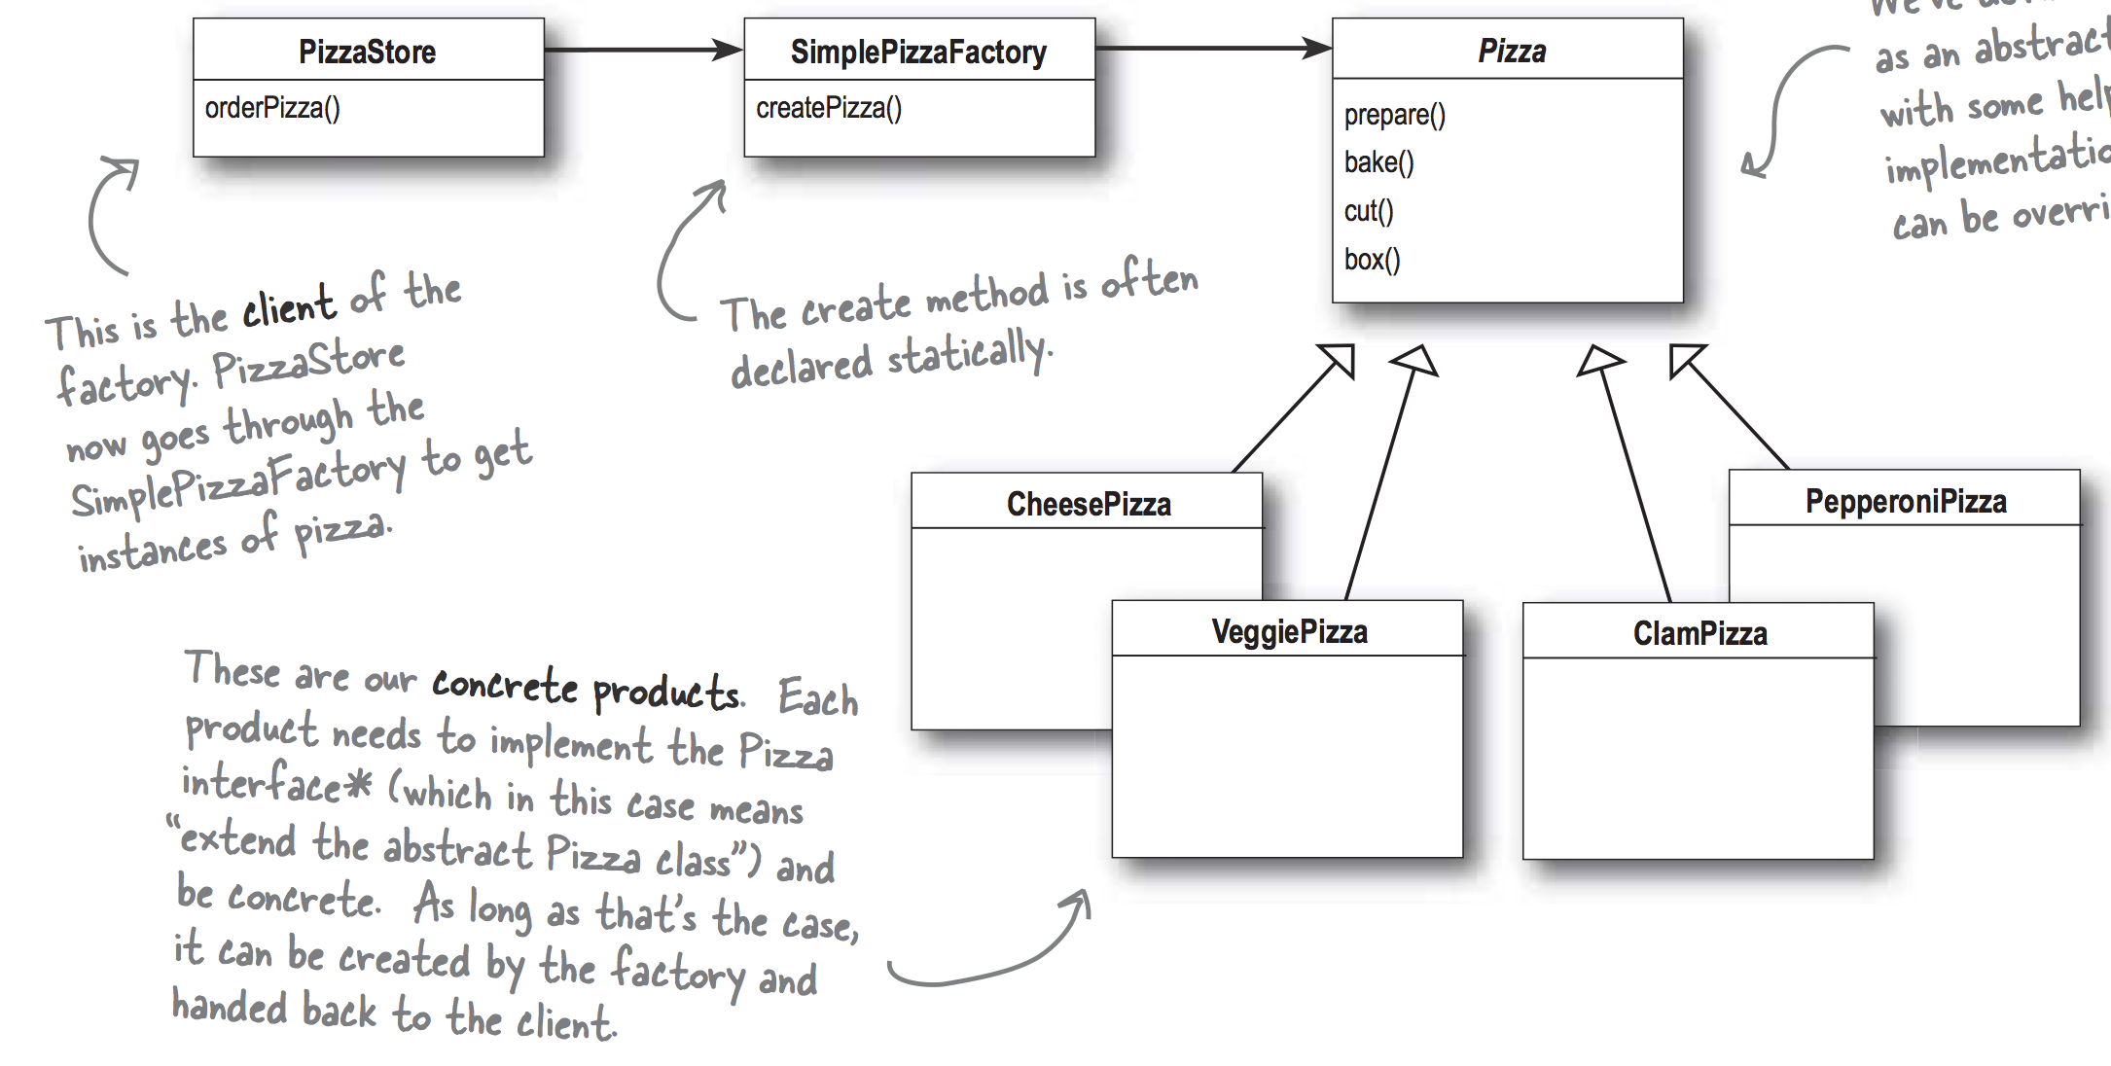
Simple Factory

Slide 10
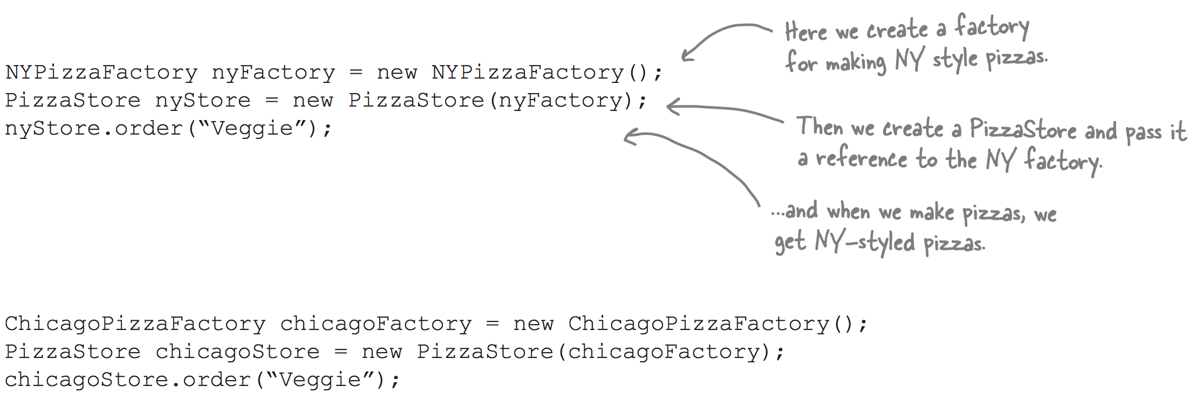
Simple Factory

Slide 11
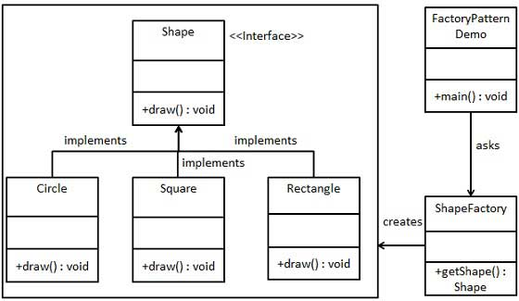
Simple Factory
In Factory pattern, we create object without exposing the creation logic to the client and refer to newly created object using a common interface.
https://www.tutorialspoint.com/design_pattern/factory_pattern.htm

Slide 12
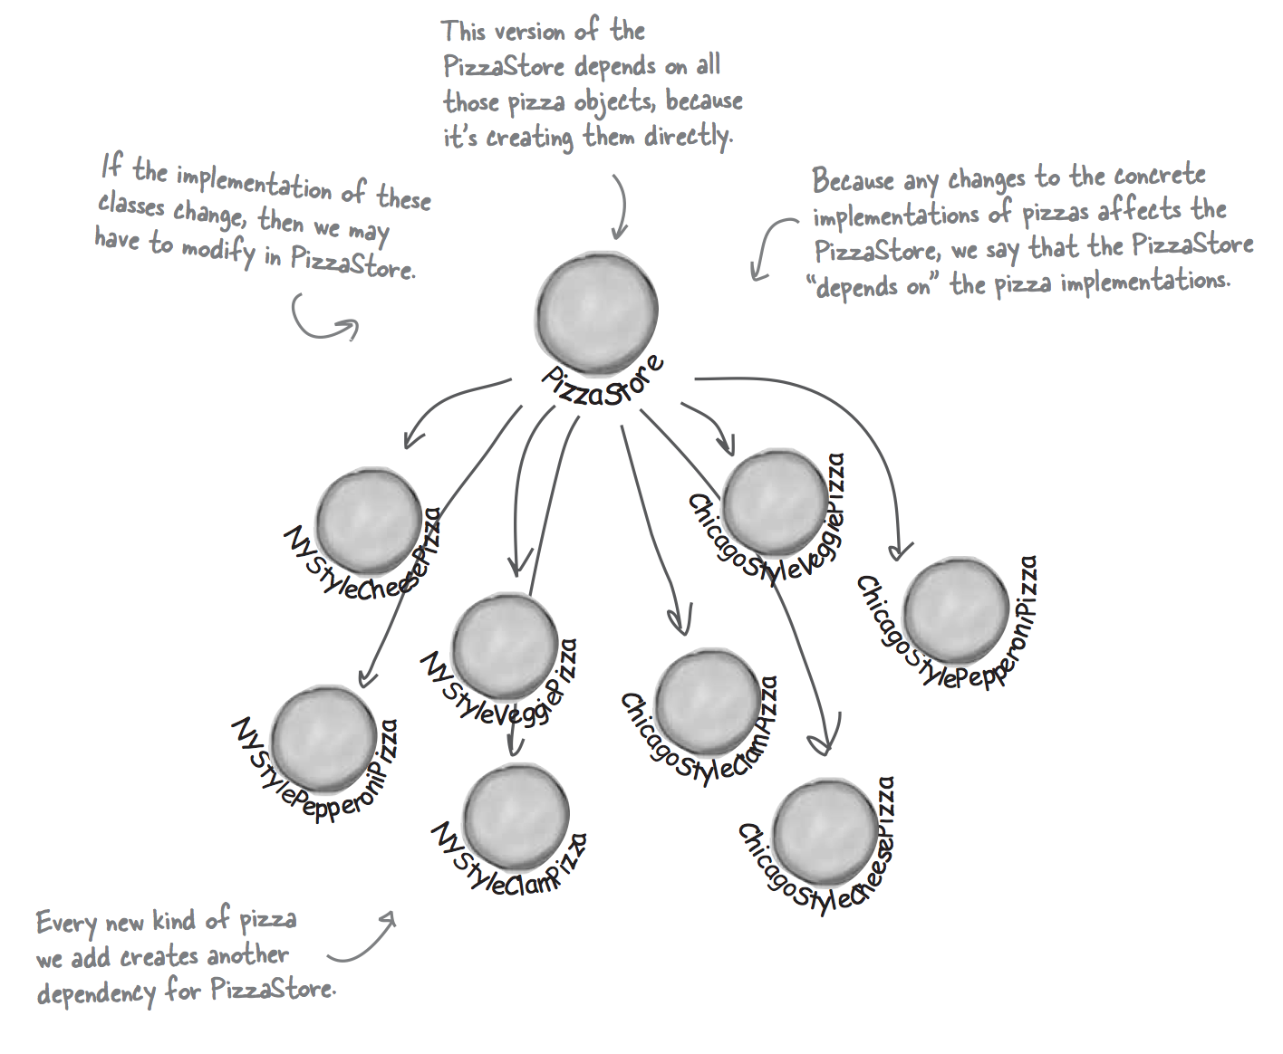
Design Principle
Depend upon abstractions.
Do not depend upon concrete classes.

Slide 13
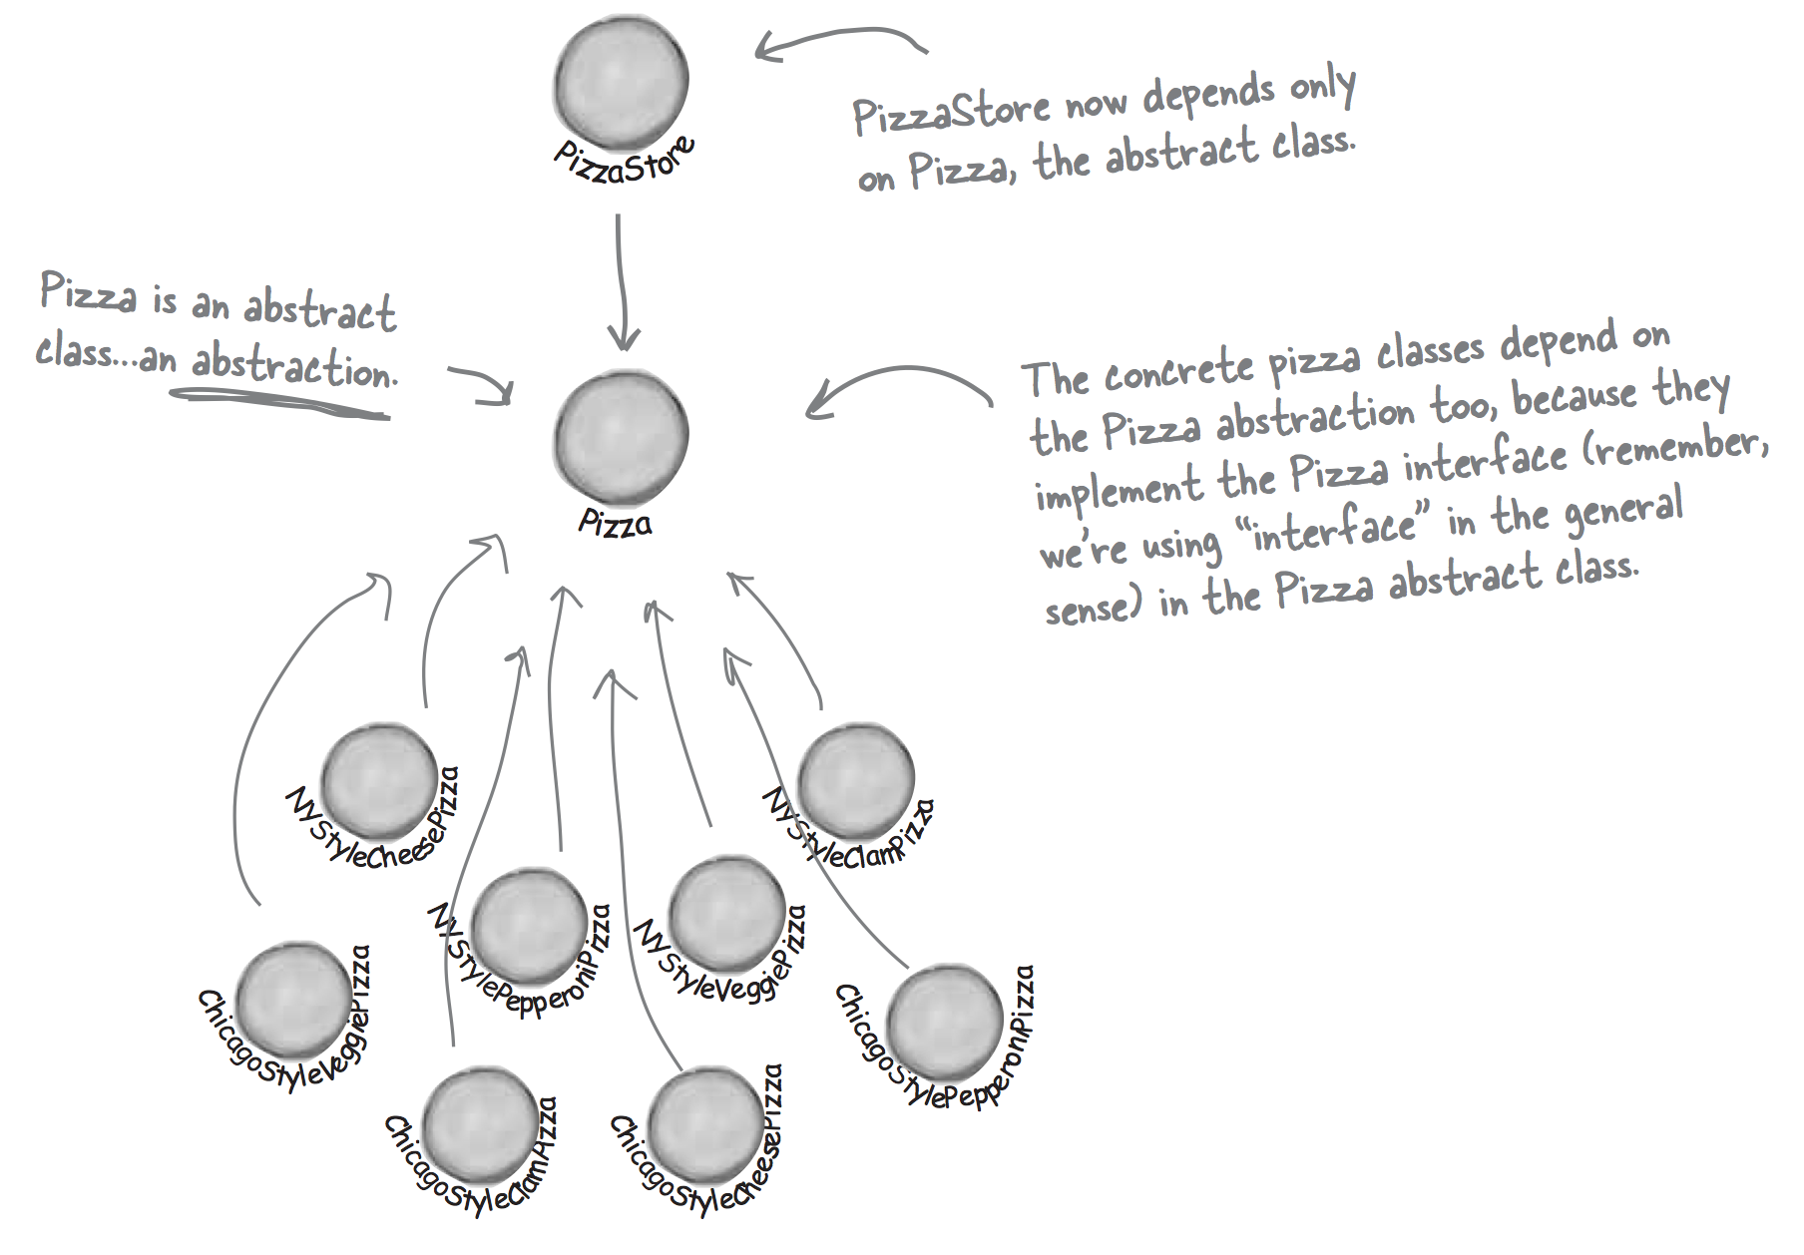
Design Principle
Dependency Inversion Principle

Slide 14
Factory Method Pattern
Define an interface for creating an object, but let subclasses decide which class to instantiate. Factory Method lets a class defer instantiation to subclasses.
e.g.: Iterators in Collections.
The intent of Factory Method is to let a class developer define the interface for creating an object while retaining control of which class to instantiate.
Source: Erich Gamma, Richard Helm, Ralph Johnson, and John Vlissides. 1995. Design Patterns: Elements of Reusable Object-Oriented Software. Addison-Wesley Longman Publishing Co., Inc., Boston, MA, USA.

Slide 15
Factory Method Pattern
Use the Factory Method pattern when:
a class can't anticipate the class of objects it must create.
a class wants its subclasses to specify the objects it creates.
classes delegate responsibility to one of several helper subclasses, and you want to localize the knowledge of which helper subclass is the delegate.
Informally speaking:
factory method pattern is used when we have a super class (i.e. abstract class) with multiple sub-classes and based on input, we need to return one of the sub-class.
This pattern take out the responsibility of instantiation of a class from client program to the factory class.
Source: Erich Gamma, Richard Helm, Ralph Johnson, and John Vlissides. 1995. Design Patterns: Elements of Reusable Object-Oriented Software. Addison-Wesley Longman Publishing Co., Inc., Boston, MA, USA.
Source: https://www.journaldev.com/1392/factory-design-pattern-in-java

Slide 16
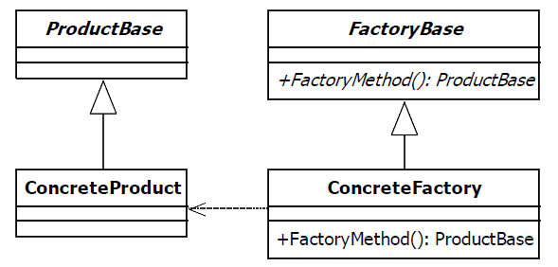
Factory Method Pattern
The factory pattern is used to replace class constructors, abstracting the process of object generation so that the type of the object instantiated can be determined at run-time.

Slide 17
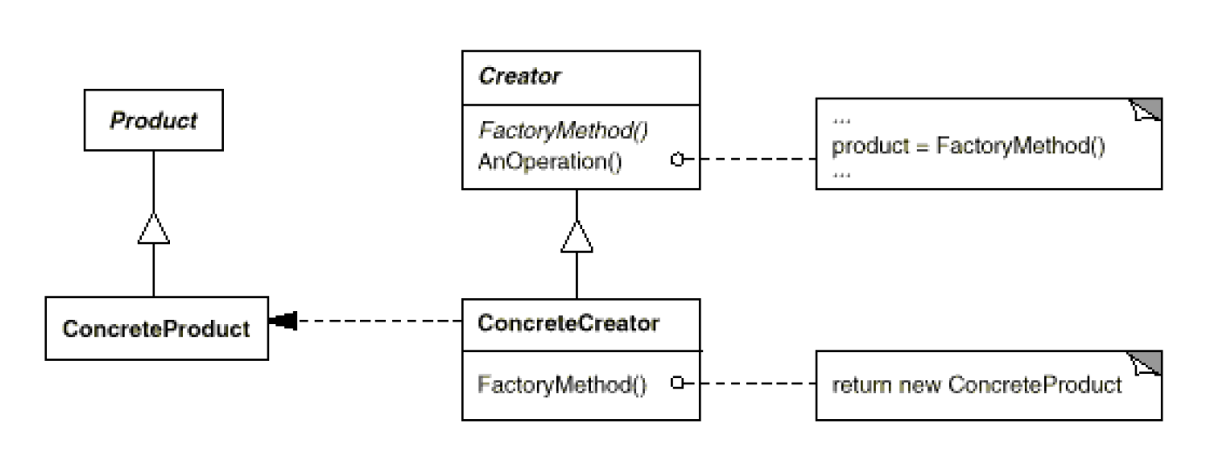
Factory Method Pattern Structure
Source: Erich Gamma, Richard Helm, Ralph Johnson, and John Vlissides. 1995. Design Patterns: Elements of Reusable Object-Oriented Software. Addison-Wesley Longman Publishing Co., Inc., Boston, MA, USA.

Slide 18
Factory Method Pattern Structure
Product (Document)
defines the interface of objects the factory method creates.
• ConcreteProduct (MyDocument)
implements the Product interface.
• Creator (Application)
declares the factory method, which returns an object of type Product. Creator may also define a default implementation of the factory method that returns a default ConcreteProduct object.
may call the factory method to create a Product object.
• ConcreteCreator (MyApplication)
overrides the factory method to return an instance of a ConcreteProduct.
Source: Erich Gamma, Richard Helm, Ralph Johnson, and John Vlissides. 1995. Design Patterns: Elements of Reusable Object-Oriented Software. Addison-Wesley Longman Publishing Co., Inc., Boston, MA, USA.

Slide 19
Factory Method Advantages
Factory methods eliminate the need to bind application-specific classes into your code.
The code only deals with the Product interface; therefore it can work with any user-defined ConcreteProduct classes.
Provides hooks for subclasses. Creating objects inside a class with a factory method is always more flexible than creating an object directly

Slide 20
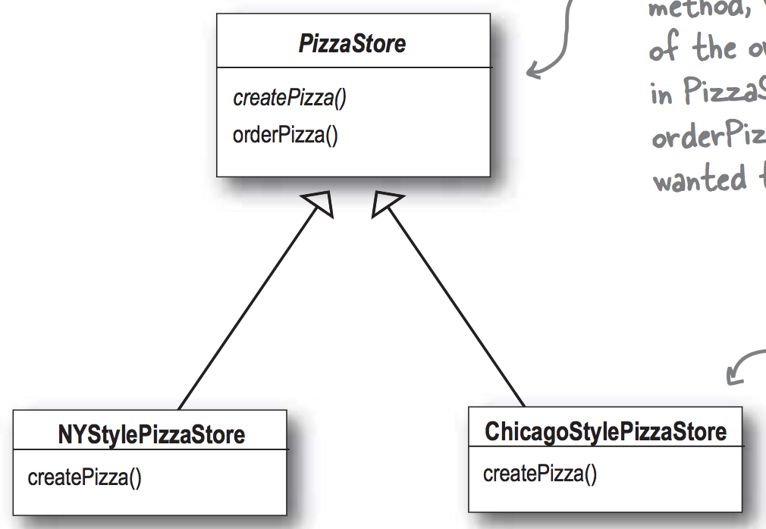
Factory Method Example

Slide 21
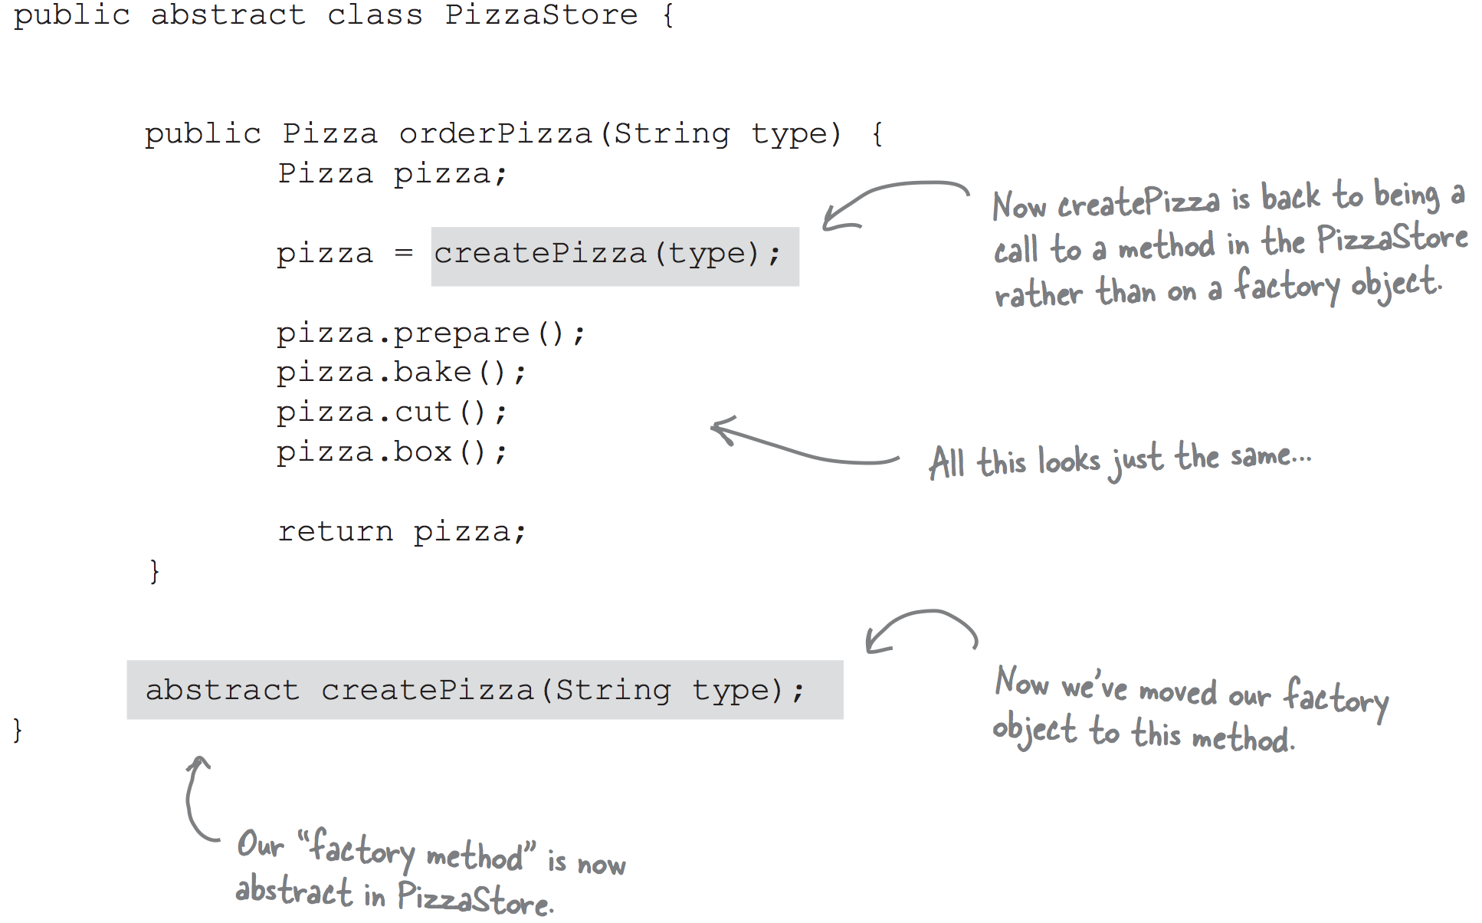
Factory Method Example

Slide 22
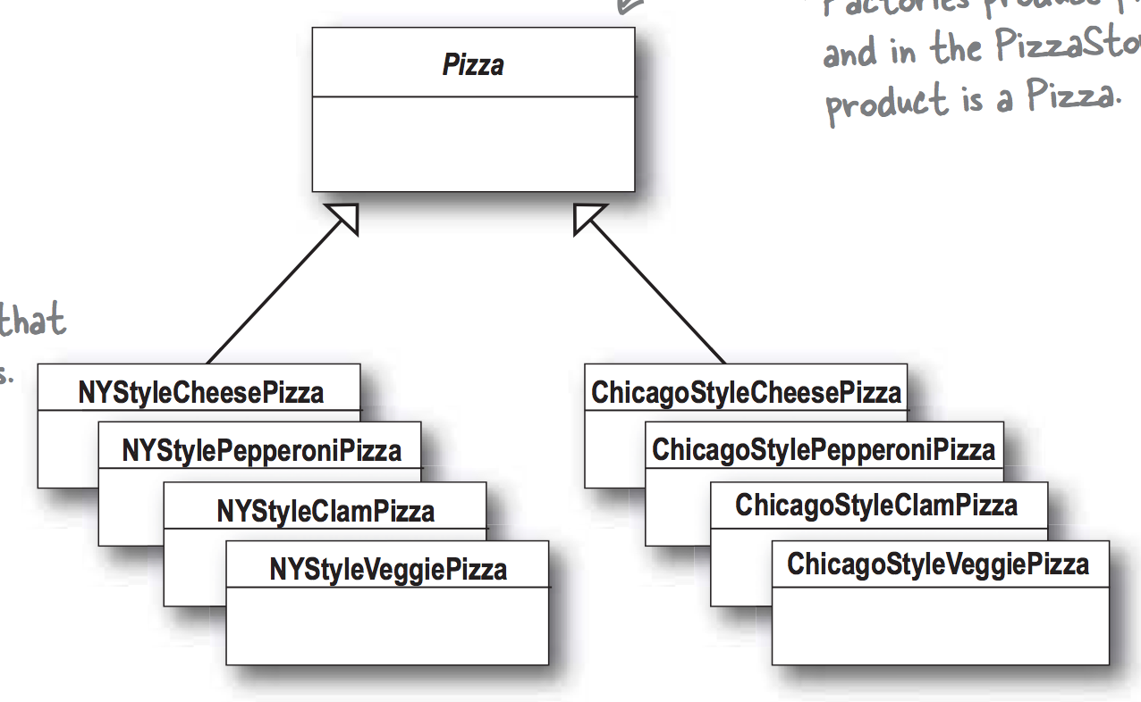
Factory Method Example

Slide 23
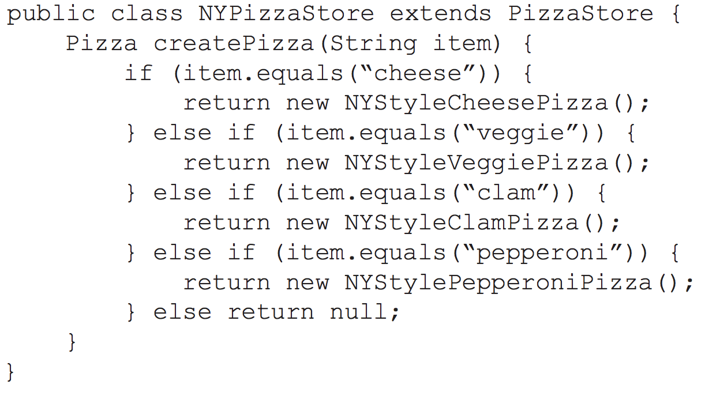
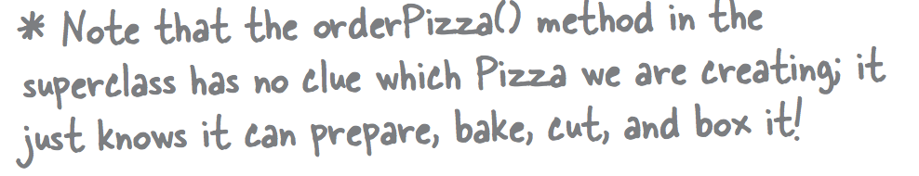
Factory Method Example

Slide 24
Abstract Factory Pattern
Provide an interface for creating families of related or dependent objects without specifying their concrete classes.
A factory that creates other factories, and these factories create objects derived from base classes.
Abstract Factory pattern can be easily extended to accommodate more products, for example we can add another sub-class Obj1 and a factory Obj1Factory.

Slide 25
Abstract Factory Pattern
Use the Abstract Factory pattern when:
a system should be independent of how its products are created, composed, and represented.
a system should be configured with one of multiple families of products.
a family of related product objects is designed to be used together, and you need to enforce this constraint.
you want to provide a class library of products, and you want to reveal just their interfaces, not their implementations.

Slide 26
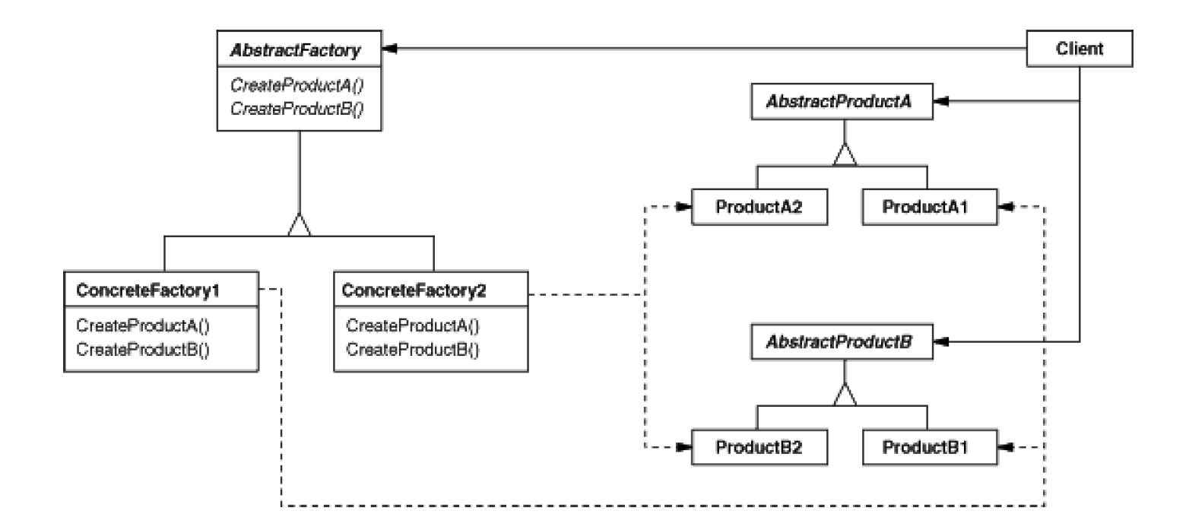
Abstract Factory Pattern Structure

Slide 27
Abstract Factory Advantages
It isolates concrete classes
control the classes of objects that an application creates.
a factory encapsulates the responsibility and the process of creating product objects
It makes exchanging product families easy
can use different product configurations simply by changing the concrete factory.

Slide 28
Prototype Pattern
Intent
Specify the kinds of objects to create using a prototypical instance and create new objects by copying this prototype.
Motivation
build an editor for music scores by customizing a general framework for graphical editors and adding new objects that represent notes, rests, and staves.
Source: Erich Gamma, Richard Helm, Ralph Johnson, and John Vlissides. 1995. Design Patterns: Elements of Reusable Object-Oriented Software. Addison-Wesley Longman Publishing Co., Inc., Boston, MA, USA.

Slide 29
Applicability
Use the Prototype pattern when a system should be independent of how its products are created, composed, and represented; and
to avoid building a class hierarchy of factories that parallels the class hierarchy of products; or
when instances of a class can have one of only a few different combinations of state; or
when the classes to instantiate are specified at run-time, for example, by dynamic loading.

Slide 30
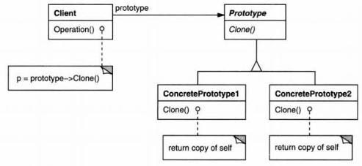
Prototype Pattern Structure
Source: Erich Gamma, Richard Helm, Ralph Johnson, and John Vlissides. 1995. Design Patterns: Elements of Reusable Object-Oriented Software. Addison-Wesley Longman Publishing Co., Inc., Boston, MA, USA.

Slide 31
Benefits
Adding and removing products at run-time.
Specifying new objects by varying values – not by defining new classes.
In fact, cloning a prototype is like instantiating a class.

Slide 32
Benefits
Reduced sub classing.
Factory Method often produces a hierarchy of Creator classes parallel to the product class hierarchy.
In Prototype, you don't need a Creator class hierarchy at all.
Configuring an application with classes dynamically.
An application that wants to create instances of a dynamically loaded class won't be able to reference its constructor statically.
Instead, the run-time environment creates an instance of each class automatically when it's loaded, and it registers the instance with a prototype manager.

Slide 33
Implementation
Using a prototype manager.
When the number of prototypes in a system isn't fixed, keep a registry of available prototypes.
Implementing the Clone operation.
The hardest part of the Prototype pattern is implementing the Clone operation correctly.
Shallow or deep?
It's particularly tricky when object structures contain circular references.

Slide 34
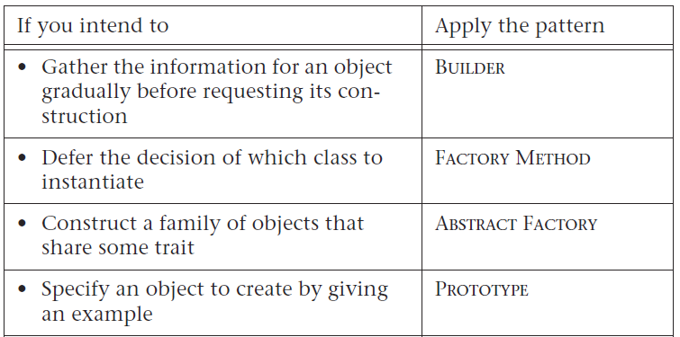
Conclusions

Slide 35
Object Pool
Intent
When objects are expensive to create, and they are needed only for short periods of time it is advantageous to utilize the Object Pool pattern.
The Object Pool provides a cache for instantiated objects tracking which ones are in use and which are available.

Slide 36
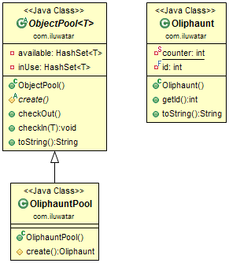
Structure Object Pool
https://java-design-patterns.com/patterns/object-pool/

Slide 37
Object Pool
Objects in the pool have a lifecycle: creation, validation and destroy.
The object pool design pattern creates a set of objects that may be reused.
When a new object is needed, it is requested from the pool.
If a previously prepared object is available it is returned immediately, avoiding the instantiation cost.
If no objects are present in the pool, a new item is created and returned.
When the object has been used and is no longer needed, it is returned to the pool, allowing it to be used again in the future without repeating the computationally expensive instantiation process.
It is important to note that once an object has been used and returned, existing references will become invalid.
https://java-design-patterns.com/patterns/object-pool/

Slide 38
Applicability
Use the Object Pool pattern when:
the objects are expensive to create (allocation cost)
E.g.: there is a need of opening too many connections for the database then it takes too longer to create a new one and the database server will be overloaded.
you need a large number of short-lived objects (memory fragmentation)
there are several clients who need the same resource at different times.

Slide 39
Advantages
Advantage of Object Pool design pattern:
It boosts the performance of the application significantly.
It is most effective in a situation where the rate of initializing a class instance is high.
It manages the connections and provides a way to reuse and share them.
It can also provide the limit for the maximum number of objects that can be created.
https://www.javatpoint.com/object-pool-pattern

